Slide 1

KIM Permissions in the KNS

Slide 2


Permission Assignment Notes
Roles can be based on other permissions.
  E.g., The Edit Document permission is assigned to a role which contains the document initiator.
Permission type services generally find the most specific permission.
  This allows global permissions to be put in place and then overridden by lower-level documents.

Slide 3
Document Level Permission Types
KR-SYS / Initiate Document
  Details: documentTypeName (uses hierarchy)
KR-NS / Open Document
KR-NS / Edit Document
  Details:
    documentTypeName (uses hierarchy)
    routeStatusCode
    routeNodeName
KR-WKFLW / Save Document
KR-WKFLW / Route Document
KR-WKFLW / Blanket Approve Document
KR-NS / Use Transactional Document
  editMode
(and others)

Slide 4
Field-Level Permission Types
KR-NS / Modify Maintenance Document Field
  Details:
    namespaceCode (can be wildcarded)
    componentName (optional)
KR-NS / View Inquiry or Maintenance Document Field
KR-SYS / Full Unmask Field
  Details:
    componentName (BO simple class name or document name)
    propertyName
KR-SYS / Partial Unmask Field

Slide 5
Other Permissions
KR-SYS / Look Up Records
  Details:
    namespaceCode (can be wildcarded)
    componentName (optional)
KR-SYS / Inquire Into Records
KR-SYS / Use Screen
  Details: actionClass (fully qualified class name)
KR-NS / Create / Maintain Record(s)
  Details:
    documentTypeName
    existingRecordsOnly

Slide 6
Other Permissions
KR-NS / Modify Maintenance Document Field
  Details:
    namespaceCode (can be wildcarded)
    componentName (optional)
KR-SYS / Inquire Into Records
KR-SYS / Use Screen
  Details: actionClass (fully qualified class name)
KR-SYS / Full Unmask Field
  Details:
    componentName (BO simple class name or document name)
    propertyName
KR-SYS / Partial Unmask Field

Slide 7
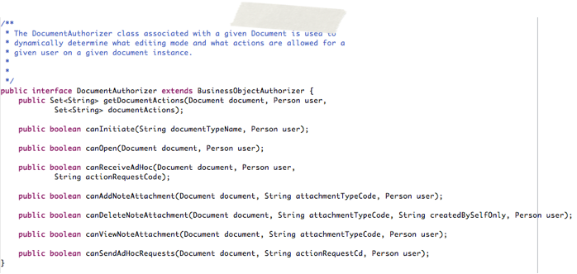
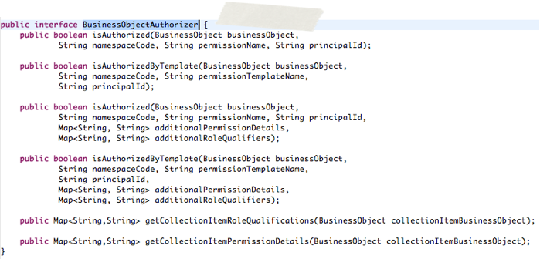
Document Authorizers

Slide 8


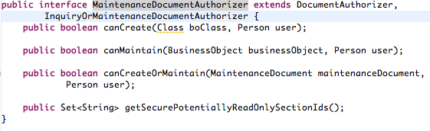
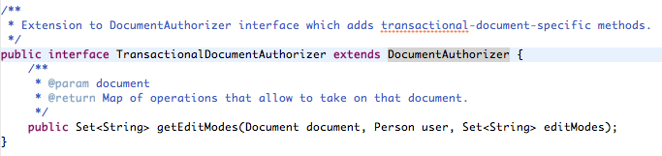
Document Authorizers

Slide 9
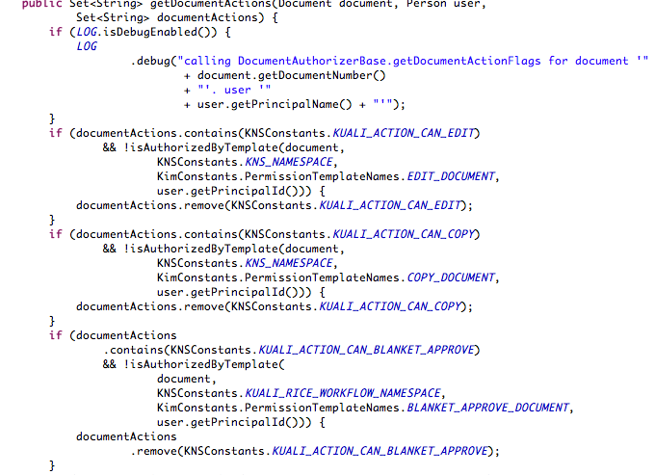
Document Authorizers

Slide 10

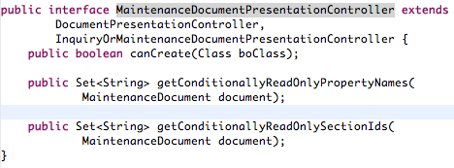
Document Presentation Controller
Used to control appearance rather than user’s actual permissions.
  Not a substitute for an authorizer class.
The actions returned from the presentation controller is post-processed by the document authorizer.
Can be used to filter out actions which should not be shown to the user given other information in the document.

